Slide 1
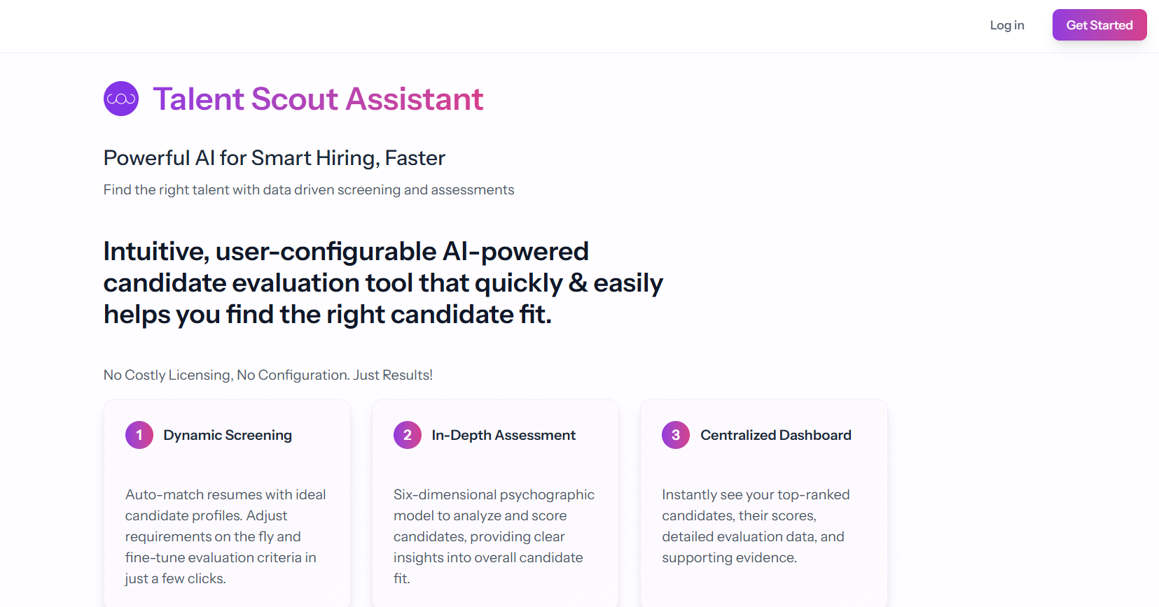
Need new Links to pages from the Home Page
Pricing
Customers
Existing page
https://app.talentscoutassistant.com/subsriptions
New page
https://app.talentscoutassistant.com/customers

Slide 2


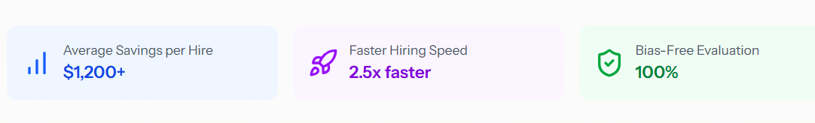






New Page
https://app.talentscoutassistant.com/customers
“Customer” page – url https://app.talentscoutassistant.com/customers
Same font style from Home Page main call-out
Our customers rely on us to find the best candidate-to-position fit, faster and easier.
Same font style from Home Page secondary
Discover how HR Professionals and Hiring Managers are using Talent Scout and leveraging AI to screen and evaluate candidates based on key skills, requirements and psychographic assessments.
Move these to here from the existing Pricing page
Same font style from Home Page box headings
Same font style from Home Page box headings
HR Professionals
Hiring Managers
Talent Scout's AI resume screening tool made it incredibly easy for us to upload job descriptions and resumes, providing clear assessment and matching scores. We were extremely impressed with the data-driven insights, which streamlined our hiring process. The outcome was fantastic, as the tool directly led us to make some of our best hires to date.
I love Talent Scout. It’s simple and effective. It has helped us review hundreds of unstructured résumés for graduate entry roles. It saves time, ensures we don’t overlook strong candidates, and removes bias from the process. It also provides traceability to demonstrate that diversity and equality were properly considered.
Can you put these in a carousel?
Can you put these in a separate carousel?
Clients in the consulting world are extremely rigorous. Finding the right balance of experience and technical skill, especially for hybrid SAP roles, is always a challenge. Talent Scout helps me quickly surface the nuanced details that often go unnoticed on a résumé.
Finding the right people is overwhelming at every level. Having a tool that anyone on the team can use anytime and with minimal training has empowered us to collaborate and confidently choose top talent together.
Talent Scout saved my Sunday. As a hiring manager, I take the initiative to review all applicants myself, especially when hiring technical talent. Talent Scout is a simple, effective tool that streamlines the evaluation process and provides the insights I need to quickly identify and dive deeper into the top candidates.

